Slide 1

Predicting Multiple Emergency Room Visits
Bellevue University - DSC 630-T302 - Project Group 1
Madhukar Ayachit, Kouevi Dosseh-Adjanon, Ryan Long
Notes:
Hello everyone, thanks for joining us today. My name is Ryan, I’m part of Project Group 1 in Bellevue University’s Fall semeter DSC 630 Predictive Analytics Class. I’m joined by my two teammates, Madhukar, and Kouevi. We’re looking forward to this discussion on the model we’ve built to predict the patients who could potentially have multiple emergency room visits, specifically more than 4 in a single year. We’ll be highlighting the work we’ve done on this model and covering some of the promising results. There are many exciting opportunities this will present for healthcare providers and potential changes to patient care in the future.

Slide 2
Table of Contents
Overview
Problem Statement
Methods
Results
Deployment
Conclusion
References
Notes:
Our discussion today is outlined by the bullets listed out on this slide. First I’ll be discussing the overview of the project and transitioning into setting the stage with our problem statement or what we are aiming to solve with our approach. Next, Madhukar will cover the Methods and Results of our modeling approach. And last but not least, Kouevi will be wrapping up our discussion with the deployment and conclusion of the model and project.

Slide 3

Overview
High cost of emergency room (ER) visits
Individual financial consequences of ER visits
Alternatives to ER visits
ER visit overusage
Insurance provider financial impact
Deployment of outreach measures
Notes:
In the healthcare industry, emergency room (ER) visits represent one of the highest cost medical services. Every year, many patients face financial burdens due to increasing hospital and medical bills mostly made up of ER visits which lead to hospitalizations.
Although most ER visits are warranted and have saved countless lives, a considerable amount of ER visits are avoidable and could be addressed with a visit to a primary care physician or even an urgent care facility, most of which have lower cost.
It is likely individuals who utilize the emergency room more than 4 times per year could be doing so unnecessarily.
Several healthcare focused entities from hospitals to insurance providers have had to implement measures to help prevent unnecessary emergency room visits. Not only do these unnecessary visits cost patients thousands of dollars out of pocket, but a significant portion is paid by healthcare insurance providers. These companies are now focusing on developing clinical outreach programs to avoid these unnecessary costs.
Our solution focuses on the application of a machine learning model with the goal to predict patients who will have more than 4 ER visits in a year. It could be a step toward diverting these patients from the ER and help them avoid these unnecessary costs.
This application leverages historical data from patients, such as demographic and clinical history, used by the algorithm to accurately predict those patients at high risk to have several needless ER visits.
The resulting predictive model would then allow care managers to prioritize their outreach to patients who are more likely to benefit from their programs.
The specific application of this model is to flag anyone with a probability score above 50% as being at a high risk and direct focus at them specifically. Nurse care managers will then engage with patients that would have a high probability score from this model to help educate and provide care to them even in their home if needed. This approach prevents or delays disease progression that could lead to a visit to the ER and reduces cost since nurse home visits are less costly.

Slide 4
Problem Statement
The problem evaluated was focused specifically on Emergency Room (ER) utilization data to help build a predictive model to understand the likelihood of a patient returning to the ER more than 4 times per year.
Scope
The data, model development, and deployment
Dataset details
Other considerations
Challenges and Issues
Limitation of the model
Pandemic conditions
Notes:
Problem Statement - The problem to be evaluated will focus specifically on Emergency Room (ER) utilization data to help build a predictive model to understand the likelihood of a patient returning to the ER more than 4 times per year.
Scope
The scope of this project is inherently defined by the data, model development, and deployment of the results focused explicitly on repeated ERs visits.
The dataset leveraged was obtained from a leading government sponsored health care provider in the United States of America and contains demographics, various metrics, and associated categorical information of healthcare patients who visited the ER over the course of a 12-month period.
Other considerations to the scope include the time period, demographic information, geographical location, and primary activities of ER visits to define the boundaries and application of the model, interpretation of the results, and subsequent deployment.
Moving onto the challenges and issues
Limitations of the data and model prohibit the use for predicting the likelihood of more than 4 ER visits per year outside of the USA or for other healthcare services.
Additionally, pandemic conditions must be considered as there has been a material decrease in ER visits during the COVID-19 pandemic, primarily due to potential patients avoiding the risk of exposure to the virus (6).
Up next, Madhukar will continue the discussion by covering the methods we used to address this problem statement.
Literature Review
Documentation and literature review performed in preparation for this project centered on multiple resource constraints healthcare providers’ face (7). Unique to the healthcare industry is patient well-being and ethical duty to provide medical services. However, healthcare providers face challenges similar to other industries such as balancing economic efficiencies with stakeholder value.
As stated previously, over half of all hospital admissions are now entering the healthcare system from ER visits (5). As a de facto front door to a hospital, emergency department activities and readmissions have been reviewed extensively. It has also been shown the ER accounts as the primary source of admissions for elderly patients as well (8). The problem statement and objective of the review is supported by continued research on analyzing and reducing readmissions to the emergency room (9, 10).

Slide 5

Methods
Technology
R & Python (Jupyter Notebook)
Data Exploration
Population & Distribution: 69K observations, 32K records indicated patients who had more than 4 ER visits, 37K with less than 4 ER visits
Target Feature: “More_Than_4_Er_Visits”
Outlier detection
Z score threshold value was “3” standard deviations
3+ Z score was marked as an outlier and replaced with the median value of that feature
Handling Null/Missing Values
The dataset contains 20 Numerical features with NaN or missing values
LabelEncoder used to transform categorical features into numeric values
11 features with an average 65 null values along with “Member_Months_Pre” with 2 and “ORCA_SCORE” being highest with 3400 null values, replaced with median values instead of deleting the records completely.

Slide 6
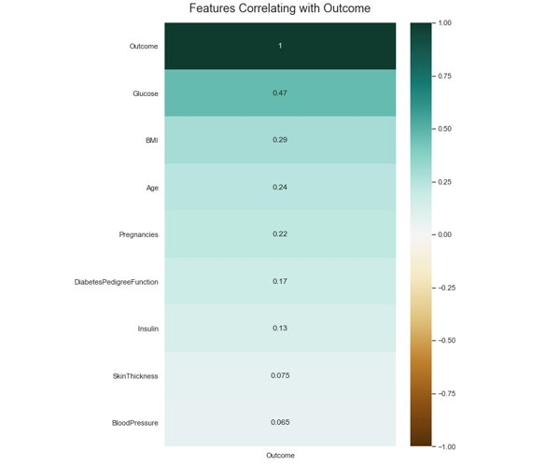
Methods
Feature selection
Considered “correlation” to identify most suitable features for modeling.
37 top correlated features into consideration with scores starting from -0.27 to 0.56
Model Preparation
Model preparation was done with “More than 4 Er” being a target variable
and the remaining 36 being independent features.
The entire dataset had previously been converted in numeric format during
preprocessing using Label Encoder and was ready for modeling.
Logistic Regression
The problem statement is focused on predicting whether a patient will either have 4 or more visits to an ER or not.
As this is a binary outcome, a Logistic Regression algorithm was chosen for modeling
Revisiting Model
After running the defined model with 100% population, a summary of the model output was used to further fine tune based on p-Value score. Two features: Country_Clean & Reg_Region_Desc were removed from feature list due to significantly higher p_value score.

Slide 7
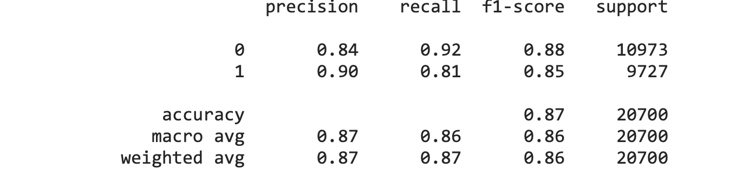
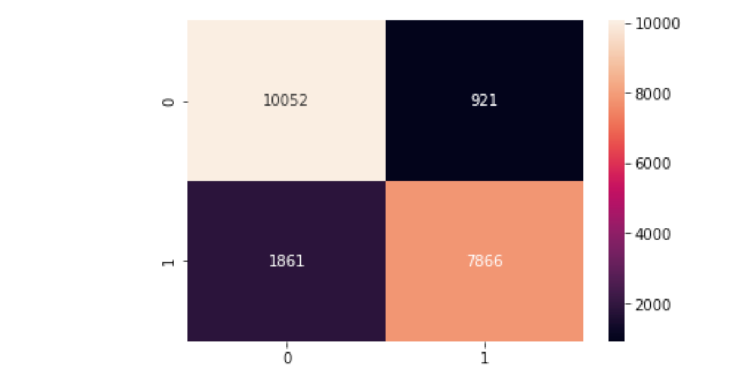
Results
Confusion Matrix and Classification Report used to conclude the exercise
We have True positive and True negative combined 17918 versus 2782 being False positive and false negative on 20700 test observation.
Accuracy
Logistic Regression Testing and Training
30% of initial dataset was set aside to serve as the testing sample
Remaining 70% of the dataset was used for training purposes.
All iterations of the Logistic Regression based on the attributes and methods documented above showed 87% accuracy.
Notes:
Results
After fine tuning the model, the following results were found.
Accuracy
In order to ensure that the Logistic Regression model performs well on new data, a portion of the initial dataset of 30% was set aside to serve as the testing sample. The remaining 70% of the dataset was used for training purposes. All iterations of the Logistic Regression based on the attributes and methods documented above showed 87% accuracy.
Confusion Matrix
Confusion matrix and heatmap visualization were generated to indicate efficiency of the model with the number of false positives, false negatives, and true negatives.
Classification Report and ROC Curve
To support performance evaluation done in previous steps, a classification report was utilized for further evaluation of forward key performance indicators: precision, recall and f1-score. All metrics indicated strong values (near 1), see below.
Additionally, an ROC Curve was plotted as a part of visual performance indicator. The spatial distance from the Logistic Regression indicates a strong metric for performance. See below.

Slide 8
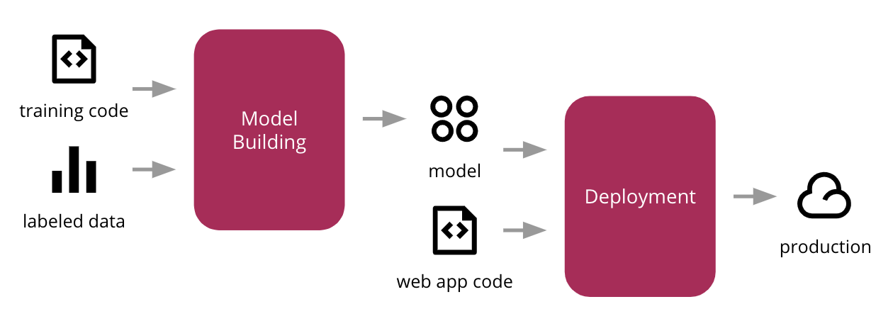
Deployment
Using the Model:
Healthcare professional involvement
Level of care
Remediation steps
Reduction of repeat visits
Potential limitations
Model Monitoring:
Ongoing performance monitoring needed
Data drift needs to be monitored
Retraining of the model if appropriate
Notes:
Discussion and Conclusion
Overall, the model developed showed favorable accuracy in the testing and training processes with the dataset available. Other metrics, such as precision, recall and f1 scores, also produced optimistic results towards the capability and potential applicability of the mode. Based on these results, this model could be used to predict the probability patients visiting the ER could return more than 4 times in a year and then potentially become readmitted to the hospital system.
When deployed, healthcare practitioners may input the same information and determine what level of care and remediation steps should be applied on a situational basis to reduce repeat visits and consequently limit impacts to the healthcare system. The only constraints would be on healthcare practitioners ability to collect the information used to create the model in addition to the scope limitations noted above.
Furthermore, after the model is deployed, ongoing monitoring should be put in place to ensure that the level of performance seen at training continues to hold true. This could require tracking actual outcome (or lack thereof) for a certain period of time and then compare these to the predictions made at the time. This will allow the project team to decide when it’s time to revisit the model and potentially re-train it if performance starts to degrade.

Slide 9
Conclusion
The model is relatively very accurate.
Precision, Recall and F1 scores are also high.
The model can be deployed to new real-life data.
Notes:
Discussion and Conclusion
Overall, the model developed showed favorable accuracy in the testing and training processes with the dataset available. Other metrics, such as precision, recall and f1 scores, also produced optimistic results towards the capability and potential applicability of the mode. Based on these results, this model could be used to predict the probability patients visiting the ER could return more than 4 times in a year and then potentially become readmitted to the hospital system.
When deployed, healthcare practitioners may input the same information and determine what level of care and remediation steps should be applied on a situational basis to reduce repeat visits and consequently limit impacts to the healthcare system. The only constraints would be on healthcare practitioners ability to collect the information used to create the model in addition to the scope limitations noted above.
Furthermore, after the model is deployed, ongoing monitoring should be put in place to ensure that the level of performance seen at training continues to hold true. This could require tracking actual outcome (or lack thereof) for a certain period of time and then compare these to the predictions made at the time. This will allow the project team to decide when it’s time to revisit the model and potentially re-train it if performance starts to degrade.

Slide 10
References
1. Brennan, J. J., Chan, T. C., Killeen, J. P., & Castillo, E. M. (2015). Inpatient Readmissions and Emergency Department Visits within 30 Days of a Hospital Admission. The western journal of emergency medicine, 16(7), 1025–1029. https://doi.org/10.5811/westjem.2015.8.26157
2. Wikimedia Foundation. (2021, June 8). Hospital readmission. Wikipedia. Retrieved September 10, 2021, from https://en.wikipedia.org/wiki/Hospital_readmission.
3. Hospital readmissions reduction Program (HRRP). CMS. (n.d.). Retrieved September 10, 2021, from https://www.cms.gov/Medicare/Medicare-Fee-for-Service-Payment/AcuteInpatientPPS/Readmissions-Reduction-Program.
4. Emergency medical Treatment &amp; Labor act (EMTALA). CMS. (n.d.). Retrieved September 10, 2021, from https://www.cms.gov/Regulations-and-Guidance/Legislation/EMTALA.
5. Morganti, K. G., Bauhoff, S., Blanchard, J. C., Abir, M., Iyer, N., Smith, A., Vesely, J. V., Okeke, E. N., & Kellermann, A. L. (2013). The Evolving Role of Emergency Departments in the United States. Rand health quarterly, 3(2), 3.
6. Hartnett, K. P., Kite-Powell, A., DeVies, J., Coletta, M. A., Boehmer, T. K., Adjemian, J., Gundlapalli, A. V., & National Syndromic Surveillance Program Community of Practice (2020). Impact of the COVID-19 Pandemic on Emergency Department Visits - United States, January 1, 2019-May 30, 2020. MMWR. Morbidity and mortality weekly report, 69(23), 699–704. https://doi.org/10.15585/mmwr.mm6923e1
7. van Baal, P., Morton, A., & Severens, J. L. (2018). Health care input constraints and cost effectiveness analysis decision rules. Social science & medicine (2018), 200, 59–64. https://doi.org/10.1016/j.socscimed.2018.01.026
8. Greenwald, P. W., Estevez, R. M., Clark, S., Stern, M. E., Rosen, T., &amp; Flomenbaum, N. (2016). The ed as the primary source of hospital admission for older (but Not YOUNGER) adults. The American Journal of Emergency Medicine, 34(6), 943–947. https://doi.org/10.1016/j.ajem.2015.05.041
9. Tsai, M. H., Xirasagar, S., Carroll, S., Bryan, C. S., Gallagher, P. J., Davis, K., & Jauch, E. C. (2018). Reducing High-Users' Visits to the Emergency Department by a Primary Care Intervention for the Uninsured: A Retrospective Study. Inquiry : a journal of medical care organization, provision and financing, 55, 46958018763917. https://doi.org/10.1177/0046958018763917
10. Kacprzyk, A., Stefura, T., Chłopaś, K. et al. “Analysis of readmissions to the emergency department among patients presenting with abdominal pain”. BMC Emerg Med 20, 37 (2020). https://doi.org/10.1186/s12873-020-00334-x

